Slide 1
SEARCH TECHNIQUES

Slide 2
In AI, search refers to a large body of core ideas that deals with deduction , inference, planning, common sense reasoning, theorem proving, and related processes.
Applications of these general ideas are found in Natural Language understanding, Information retrieval, Automatic programming, Robotics, Scene Analysis, Game playing, Expert systems and Mathematical theorem proving.
Search systems have three components
Database : Describes the current task domain and the goal.
Operators : Are used to manipulate the database.
Control strategy : Decides what operators to apply and where.

Slide 3
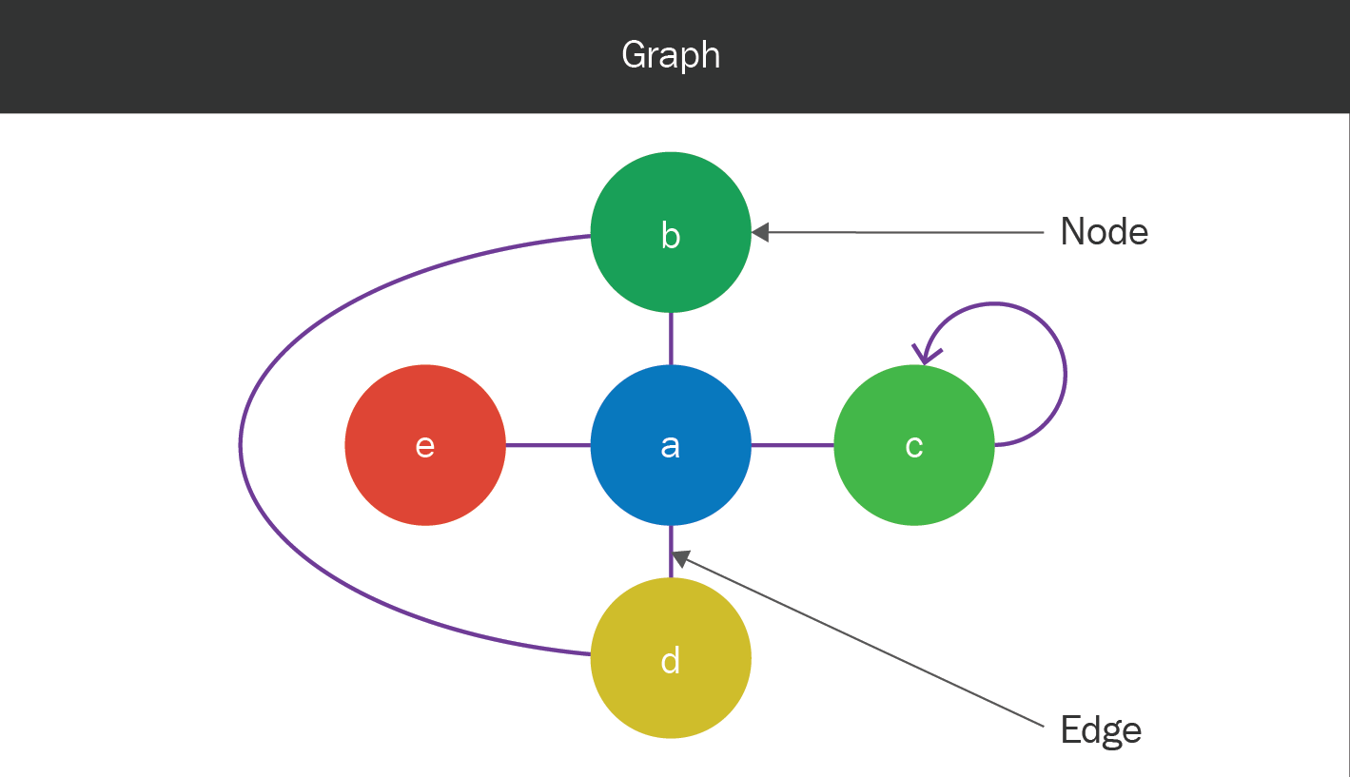
Definitions
Graph : A graph is a data object. A graph consists of two sets called vertices and Edges.

Slide 4
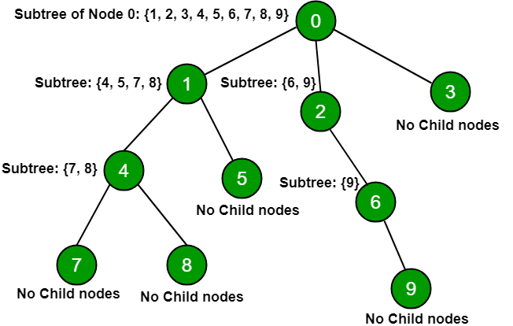
Tree
A tree is a finite set of one or more nodes such that :
There is specially designated node called the root.
The remaining nodes are partitioned into n>=0 disjoint sets T1,......,Tn, where each of these sets is a tree. T1,…,Tn are called the subtrees of the root.

Slide 5
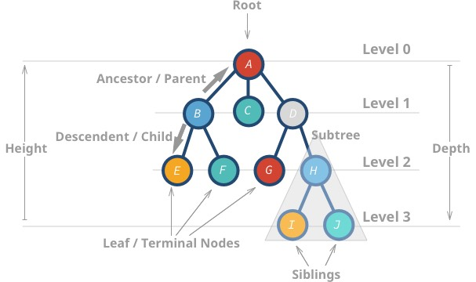
Root node, terminal node and children
The node at the top of a tree, the one with no parent is called the root node. The nodes at the bottom of a tree, the one with no children,are called the terminal nodes. If any node is connected to some other node or nodes through branches, then the nodes to which it is connected are called its children

Slide 6
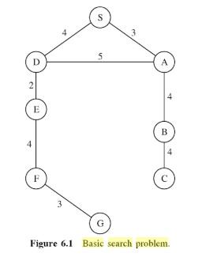

Representation Schemes
In analysis and solving problem, the tree structures are commonly used to represent the control strategies to the search.
In state-space representation, a tree may be used to represent the set of problem states produced by the application of the operators.
In such a representation, the root node of the tree represents the initial problem state or situation.
Each of the new states that can be obtained by applying only one operator to the root is represented as the successor node of the root node .
Subsequent operator applications produce successors to these nodes and so on.
Each operator application is represented as a directed edge of the tree.

Slide 7
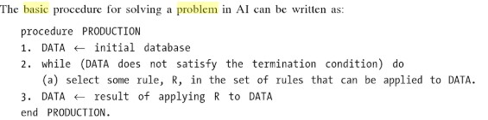
Problem Solving in AI
The fundamental control problem is selecting the rule R to apply to the database. An important characteristics in this regard is the amount of “Knowledge” of information at hand that these computations use. Such a search procedure uses the knowledge where the selection is made arbitrarily.

Slide 8
Types of Search Techniques
Blind search algorithms: use a fixed strategy to methodically traverse the search tree. Blind search is not suitable for complex problems as the large search space (number of different possible states to search) makes them impractical given time and memory constraints. Ex: BFS, Uniform cost, DFS, depth limited, iterative deepening search.
Heuristic (Best-first) search algorithms : use a heuristic function to determine the order in which nodes are traversed, giving preference to states that are judged to be most likely to reach the required goal. Using a "heuristic" search strategy reduces the search space to a more manageable size. Ex: greedy, hill-climbing,A*, 8-puzzle problem, branch and bound search

Slide 9
Breadth-First Search(BFS)
It starts from the root node, explores the neighbouring nodes first and moves towards the next level neighbours. It generates one tree at a time until the solution is found. It can be implemented using FIFO queue data structure. This method provides shortest path to the solution.
Example of Breadth First Search
As breadth-first search exhaustively examines every node at a particular depth before progressing to the next level, it is guaranteed to find the solution, if one exists, with the shortest path from the initial state. A disadvantage of breadth-first search is that it can have a high memory requirement - as a record needs to be maintained of every expanded node.

Slide 10
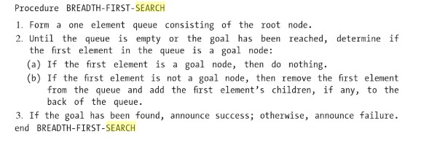
BREADTH-FIRST-SEARCH Algorithm

Slide 11
Uniform Cost Search
If all the edges in the search graph do not have the same cost then breadth-first search generalizes to uniform-cost search.
Instead of expanding nodes in order of their depth from the root, uniform-cost search expands nodes in order of their cost from the root.
At each step, the next step n to be expanded is one whose cost g(n) is lowest where g(n) is the sum of the edge costs from the root to node n. The nodes are stored in a priority queue.
Whenever a node is chosen for expansion by uniform cost search, a lowest-cost path to that node has been found.
Unfortunately, it also suggests the same memory limitation as breadth-first search.

Slide 12
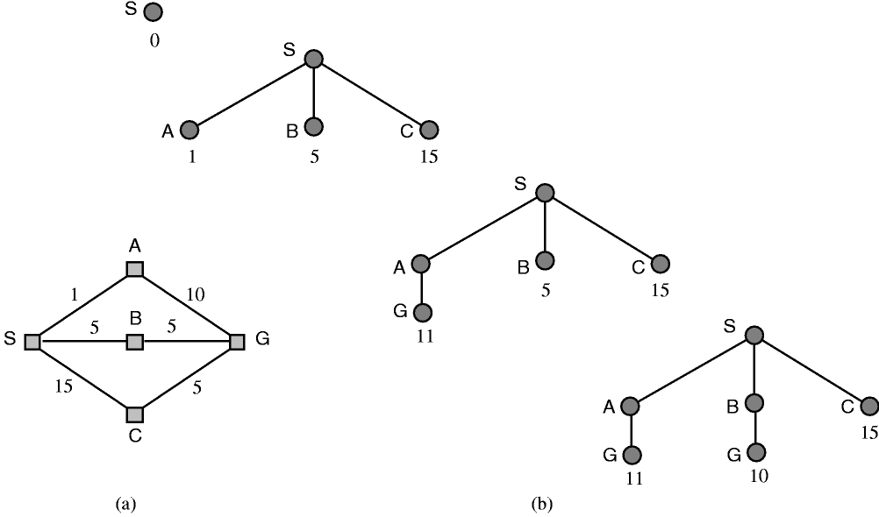

Slide 13
Depth-First Search
Depth-first search starts at the root node and continues down a particular path (branch) - selecting a child node at the deepest level of the tree to expand next. Only when the search hits a dead end (a node that has no child nodes) does the search "backtrack" - continuing the search from the last node it encountered whose child nodes have not been fully examined.
Procedure DEPTH-FIRST-SEARCH
Form a one element consisting of the root node.
Until the queue is empty or the goal node, then remove the first element from the queue and add the first element’s, if any, to the front of the queue.
If the goal has been found, announce success; otherwise announce failure.
End DEPTH-FIRST-SEARCH

Slide 14
DEPTH-FIRST-SEARCH Algorithm Example

Slide 15
Depth-limited search (DLS)
The problem with DFS is that the search can go down an infinite branch and thus will never return.
DLS avoids this problem by imposing a depth limit which effectively terminates the search at the depth.
The algorithm can be implemented with the general search algorithm by using operators to keep track of the depth.
The choice of depth parameter is an important factor. If it is too deep is wasteful in terms of both time and space. If is too shallow, then it may result in never reaching a goal state.

Slide 16
Description:
The unbounded tree problem appeared in DFS can be fixed by imposing a limit on the depth that DFS can reach, this limit we will call depth limit l, this solves the infinite path problem.
Performance Measure:
Completeness:
As long as the depth parameter(l) is set ‘deep enough’ we are guaranteed to find a solution if it exists.
Therefore it is complete as long as l>=d(where d is depth of the solution)
The limited path introduces another problem which is the case when we if we choose l < d, in which our DLS will never reach a goal, in this case we can say that DLS is not complete.
DLS can be used when there is a prior knowledge to the problem, which is always not the case, Typically, we will not know the depth of the shallowest goal of a problem unless we solved this problem before.

Slide 17
Iterative Deepening Search
Iterative deepening search (IDS) operates like depth-first search.
apart from that the algorithm imposes a limit on how deep the search traverses.
Until a goal state is found, the search is repeated with an increased depth limit.
It just tries all possible depth limits., first 0, then 1, then 2 and so on until a solution is found.
It just combines both BFS and DFS.
It may appear wasteful as if it is expanding nodes multiple times. However the overhead is small in comparison to the growth of an exponential search tree.

Slide 18
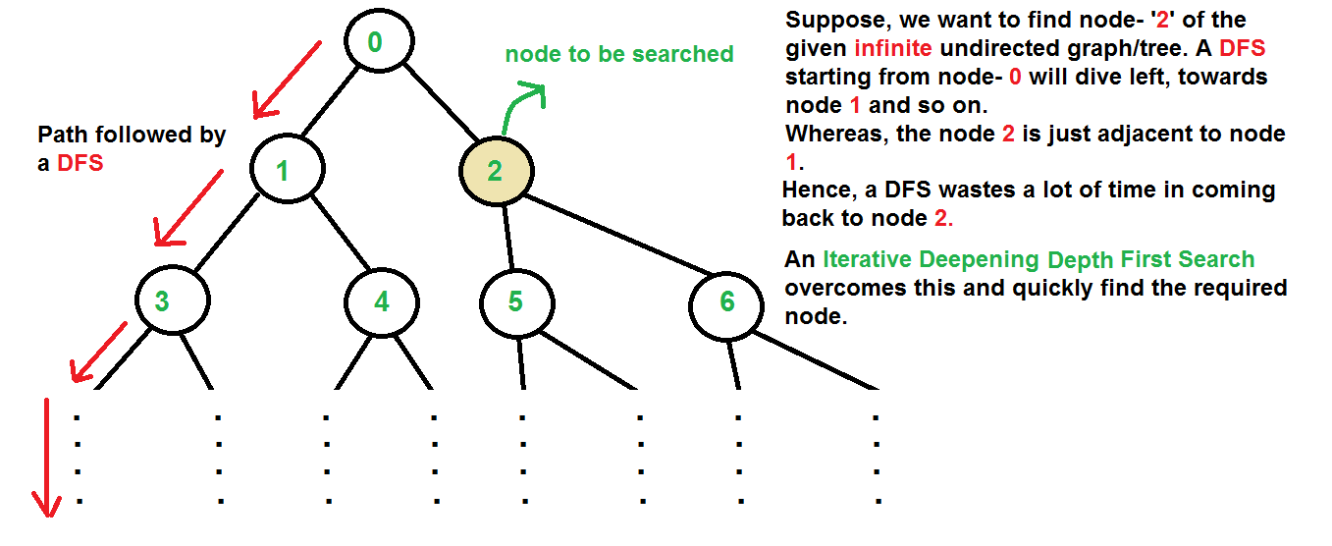

Slide 19
Example of Iterative Deepening Search
Iterative deepening depth-first search combines advantages of both breadth-first and depth-first search. By continuously incrementing the depth limit by one , until a solution is found.
iterative deepening depth-first search has the same strength as breadth-first search regarding always finding the shortest path to a solution.
By using a depth-first approach on every iteration, iterative deepening depth-first avoids the memory cost of breadth-first search.

